Slide 1
DATA ENCODING
Group 3
NAME | REG NO
RWAKASIISI EDWIN | 22/U/6853
LUTALO ALLAN | 22/U/3330/PS
NAKANWAGI VANESSA | 22/U/6530
NKETAMUKAMA TARASISIO | 22/U/3685/PS
NTEGEKA K PIUS | 22/U/3700/PS

Slide 2
Definition
Data encoding is the converting data from one form to another ,typically for the purpose of transmission, storage, or analysis.
To transmit data digitally, it needs to be converted to digital form
Digital to digital encoding means conversion of digital data into digital signals.

Slide 3
How Data Encoding is done?
This conversion can be done in two ways;
Line coding
Block coding
Scrambling

Slide 4
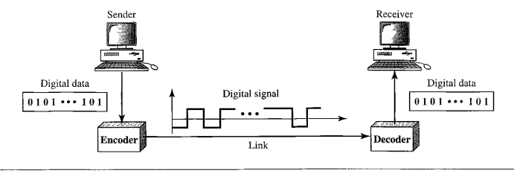
Line Coding
The process of converting digital data into digital signals
Digital data – found in binary format (zeros and ones)
Digital signal – is denoted by discrete signal

Slide 5
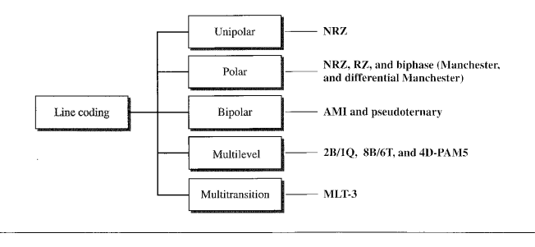
Line Coding Schemes

Slide 6
Unipolar Scheme
In a unipolar scheme, all the signal levels are on one side of the time axis, either above or below.
NRZ (Non-Return-to-Zero) Traditionally, a unipolar scheme was designed as a non-return-to-zero (NRZ) scheme in which the positive voltage defines bit 1 and the zero voltage defines bit 0. It is called NRZ because the signal does not return to zero at the middle of the bit.

Slide 7
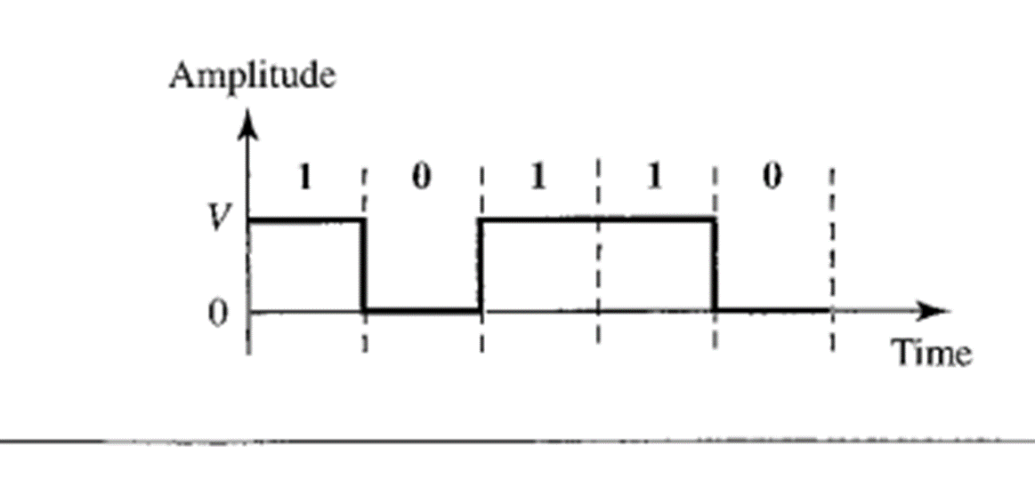

Slide 8
Polar Schemes
In polar schemes, the voltages are on the both sides of the time axis. For example, the voltage level for 0 can be positive and the voltage level for 1 can be negative.
Non-Return-to-Zero (NRZ)
Two levels of voltage amplitude are used
Two versions of NRZ: NRZ-L and NRZ-I
In the first variation, NRZ-L (NRZ-Level), the level of the voltage determines
the value of the bit. In the second variation, NRZ-I (NRZ-Invert), the change or lack of
change in the level of the voltage determines the value of the bit. If there is no change,
the bit is 0; if there is a change, the bit is 1.

Slide 9
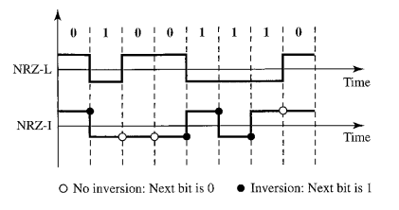
In NRZ-L the level of the voltage determines the value of the bit. In NRZ-I the inversion or the lack of inversion determines the value of the bit.

Slide 10
Return to Zero (RZ)
The main problem with NRZ encoding occurs when the sender and receiver clocks are not synchronized. The receiver does not know when one bit has ended and the next bit is starting. One solution is the return-to-zero (RZ) scheme, which uses three values: positive, negative, and zero. In RZ, the signal changes not between bits but during the bit.
The main disadvantage of RZ encoding is that it requires two signal changes to encode a bit and therefore occupies greater bandwidth. The same problem we mentioned, a sudden change of
Another problem is the complexity: RZ uses three levels of voltage, which is more complex to create and discern. As a result of all these deficiencies, the scheme is not used today. Instead, it has been replaced by the better-performing Manchester and differential Manchester schemes (discussed next)

Slide 11
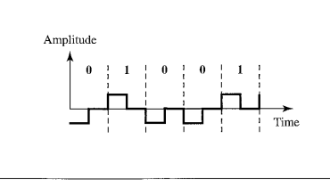

Slide 12
Manchester and Differential Manchester
The idea of RZ (transition at the middle of the bit) and the idea of NRZ-L are combined into the Manchester scheme.
In Manchester encoding, the duration of the bit is divided into two halves. The voltage remains at one level during the first half and moves to the other level in the second half.
The transition at the middle of the bit provides synchronization. Differential Manchester, on the other hand, combines the ideas of RZ and NRZ-I. There is always a transition at the middle of the bit, but the bit values are determined at the beginning of the bit. If the next bit is 0, there is a transition; if the next bit is 1, there is none.

Slide 13
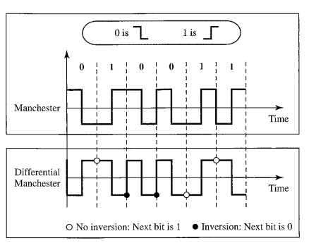

Slide 14
Satellite Encoding
the process of converting audio, video, and data signals into a format that can be transmitted efficiently over a satellite link.
This involves several steps:
Digitization: If the signal is analog, it must first be converted into a digital format. This is typically done using an analog-to-digital converter (ADC).
Compression: Digital signals are very large, so they need to be compressed to fit within the limited bandwidth of a satellite channel. This is done using a codec, such as MPEG-2, MPEG-4, or HEVC.
Modulation: The compressed signal is then modulated onto a carrier frequency, which is a high-frequency signal that can be transmitted over long distances. This is done using a modulator.
Error correction: To ensure that the signal arrives at the receiver intact, error correction codes are added to the signal. This is done using an error correction encoder.
Encryption: In some cases, the signal may also be encrypted to prevent unauthorized access. This is done using an encryption algorithm.

Slide 15
Thank You

